Slide 1
Configuring a TempTale Ultra
FNIHB – Alberta Region
December 2019

Slide 2
Configuring a TempTale Ultra Monitor
Slides 3 – 6: What is a TempTale
Slides 7 – 8: Where to use a TempTale
Slide 9 – 15: Configuring a TempTale
Slide 16 – 17: Step 1 – Connect to a Monitor
Slide 20: Christmas Settings
Slide 18 – 40: Step 2 – Select Configuration
Slide 41: Alarm Status Displays
Slide 42 – 43: Step 3 – Save Configuration
Slide 44: Summary – Configuring a TempTale
Slide 45: Summary – Suggested Settings
Slide 46: Note

Slide 3
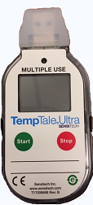
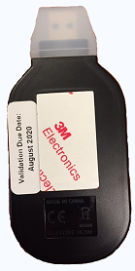
What is a TempTale?
Multiple Use TempTale Ultra

Slide 4
What is a TempTale?
A TempTale is a type of data logger: a miniature, battery-powered, stand-alone temperature monitor.
They can record hundreds of temperature readings.
They are Multiple Use.
They are NOT disposable.
They identify exactly when a cold chain excursion (break) occurred and for how long it lasted. How long the vaccine remained out of range (2 – 8°C).
Useful for monitoring the vaccine fridge more precisely, transporting vaccines, or when vaccine bags are being used.

Slide 5
What is a TempTale?
The TempTale meets the requirements for temperature monitoring for vaccines according to Alberta Health’s: Alberta Vaccine Storage and handling Policy for Provincially Funded Vaccines (December 17, 2018) document.

Slide 6
What is a TempTale?
The battery life for the TempTale Ultra Monitor is one year.
See the validation due date located on the back of the monitor.
By this date the whole unit must be replaced.
If not replaced, the monitors will not be validated and ongoing battery life is not guaranteed.
Order new TempTales prior to the validation due date to ensure they are received on time.

Slide 7
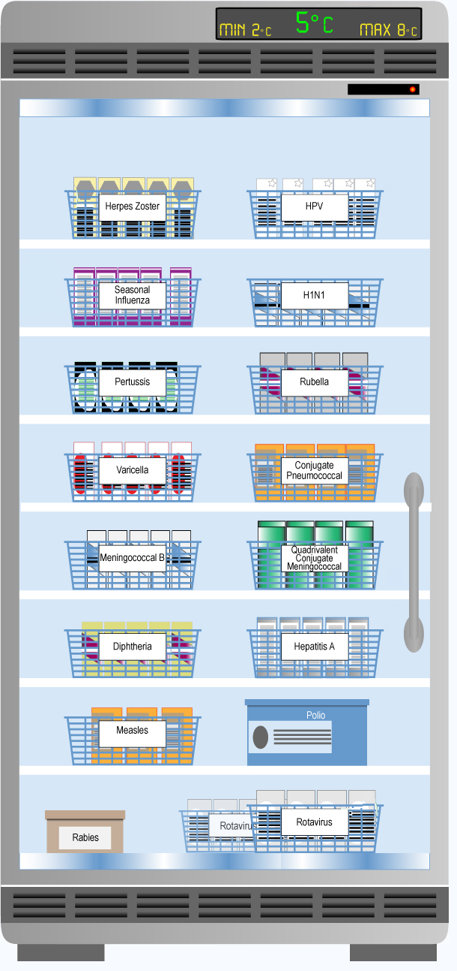
Where to use a TempTale
Vaccine Fridge
A TempTale is to be placed in each vaccine fridge to continuously document the temperature of the fridge.
The TempTale is to be used in addition to the min/max thermometer. Min/max thermometer readings for vaccine fridges must continue to be documented twice per day.

Slide 8
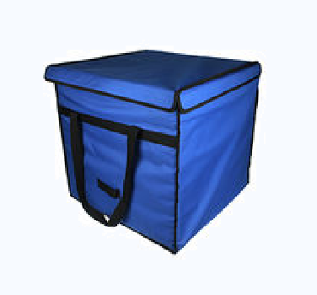
Where to use a TempTale
Vaccine Bags
A TempTale is to be placed in each vaccine bag when vaccines are being used or transferred.
TempTales for vaccine bags can be stored in the vaccine fridge until needed.

Slide 9
Configuring a TempTale
New TempTales
Prior to use, you must choose the settings for the new TempTale monitor.
This is called “configuring.”
Sensitech’s TempTale Manager® Desktop (STTMD) software must be downloaded to the computer.
Instructions follow.
Configuring only needs to be done once for each TempTale.

Slide 10
Configuring a TempTale
Important Note
A government issued computer can not be used to configure (set up) or download the TempTales.

Slide 11
Configuring a TempTale
Download Software
To download Sensitech’s TempTale Manager® Desktop (STTMD) software:
Use the link provided by the CDC team.
Alternatively, you may contact Sensitech directly by emailing clientservices@sensitech.com to obtain a link.
Note: The link is only active for 24 hours

Slide 12
Configuring a TempTale
Download Software
Once you receive the 24 hour link:
Click on the link.
Click “Open” → “Allow.”
The Sensitech’s TempTale Manager® Desktop (STTMD) software will begin installing.
Click “Next” → “Finish” x3.
The STTMD icon will appear on your computer desktop once installation is complete.

Slide 13
Configuring a TempTale
Connect TempTale to Computer
Once the STTMD software has been installed on your computer:
Remove the rubber cap from the TempTale and plug it into the computer USB port.
The TempTale should be off and the LCD monitor should be blank. If not, press the Stop button for 1 – 3 seconds.
Double click the TTV/TTMD file icon from the window that automatically appears when the TempTale is plugged in to the computer USB port. If no window popped-up, you may find this icon on your computer desktop.
At the top left corner, click “Actions” then “Configure Monitor.” (Image on next slide).

Slide 14
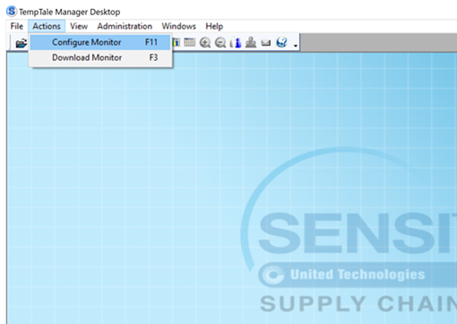
Configuring a TempTale
Click “Actions,” then from the dropdown menu, click “Configure Monitor.”

Slide 15
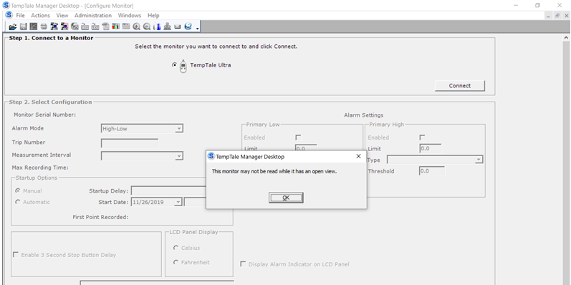
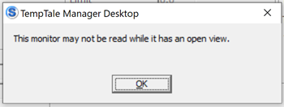
Configuring a TempTale
Do not click the top “x” until you are ready to exit out of the TTMD.
Note: If this window appears:
Click “OK,” then
Click the bottom “x” to close the background window and try again.

Slide 16
Step 1. Connect to a Monitor
Letter | Field | Description
A | Select the monitor you want to connect and click connect. | Select TempTale Ultra. This will configure the TempTale Ultra monitor. (Allow you to select the settings).
B | Connect. | Click Connect. This will then show the current configuration details of the attached TempTale monitor.
(Images follow)

Slide 17
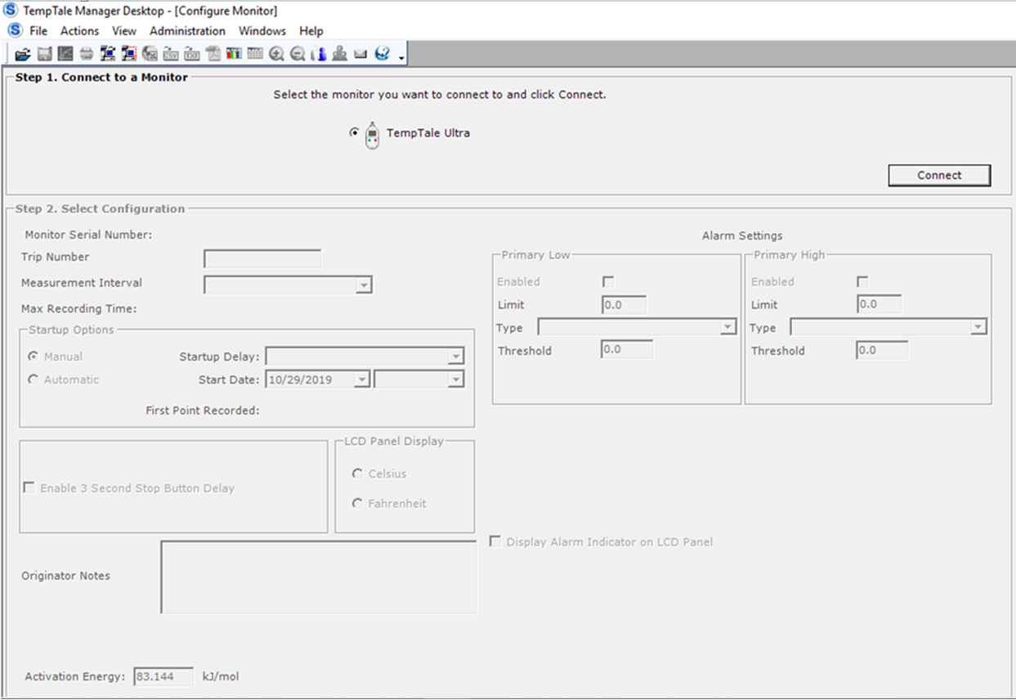
A
B

Slide 18
Step 2. Select Configuration
Letter | Field | Description
C | Monitor Serial Number | Display only. This is the monitor’s (unique) serial number which is assigned during manufacturing.
D | Alarm Mode | Select High-Low. An alarm status will appear if the temperature rises/falls outside the set range.
E | Trip number | Select 0.

Slide 19
Step 2. Select Configuration
Letter | Field | Description
F | Measurement Interval | Click the arrow icon for drop-down list options. Select desired recording interval (how often it will record temperature). Suggested to select 1 minute. For example, a value of 1 minute indicates that a temperature value will be recorded at 1-minute intervals.
G | Max Recording Time | Display only. This value is calculated based upon the selected measurement interval [F] and the data-point capacity of the monitor. For example, if measurement intervals are set to 1 minute, the monitor will be full at 11d 2hrs 40min. This is why it is important to clear the monitor weekly.

Slide 20
Christmas Settings
If the TempTale monitor will not be downloaded weekly over the Christmas holidays, the “Measurement Interval” [F] should be changed to 3 minutes on the last day the health centre is open. This will make sure the TempTale doesn’t run out of storage space.
(Check the “Max Recording Time” field [G] to make sure that the appropriate time will be covered).
The min/max thermometer temperatures should still be documented for the vaccine fridge over Christmas.
Change the measurement Interval [F] back to 1 minute after the Christmas Break.

Slide 21
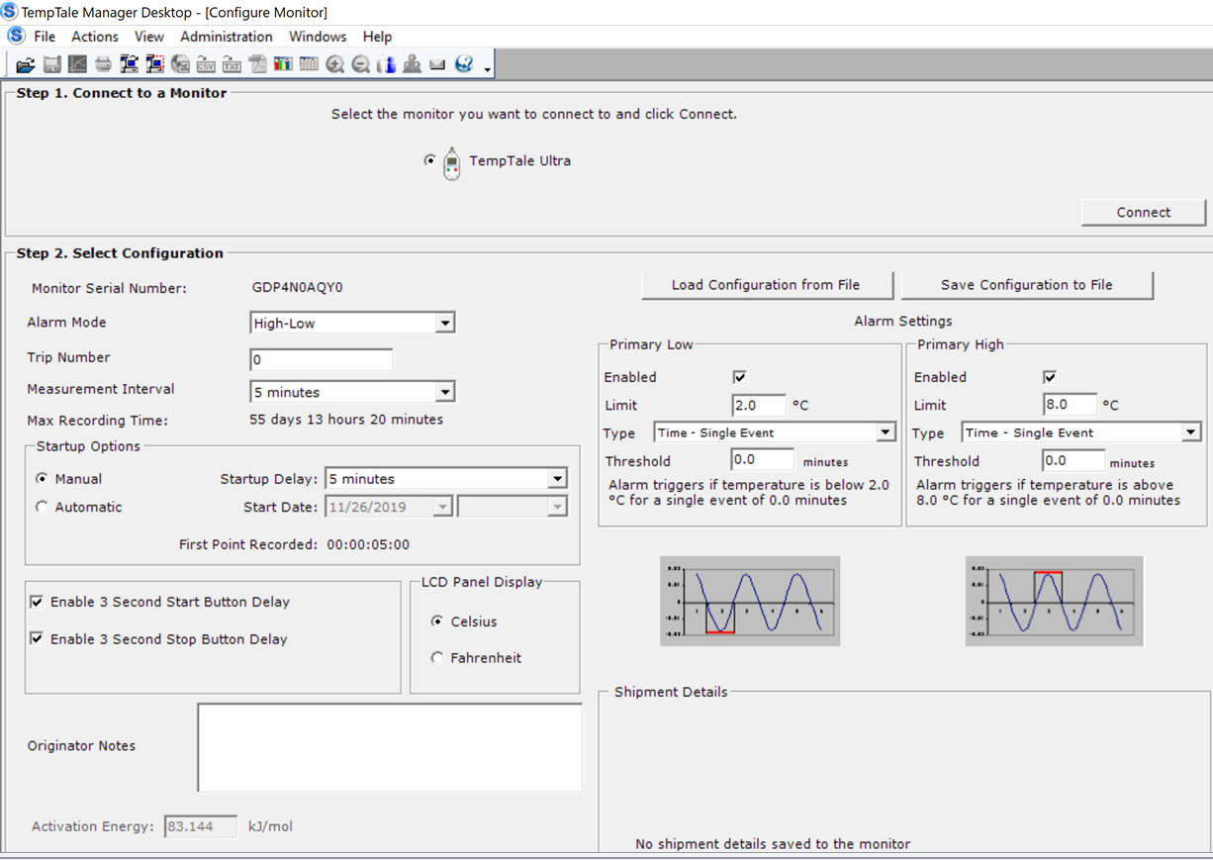
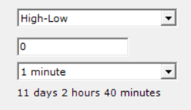
C
D
E
F
G

Slide 22
Step 2. Select Configuration
Letter | Field | Description
Startup Options
H | Manual or Automatic | Select Manual option. Manual: the monitor will not start until the Start button is pressed. The first point will be recorded after the defined Startup Delay [I] time period (if configured) has expired. Automatic: if selected, the monitor will start automatically after it is configured It will automatically begin recording date and time selected in the Start Date [J] and Time [J] fields.

Slide 23
Step 2. Select Configuration
Letter | Field | Description
Startup Options
I | Startup Delay | Select a value from the drop-down list using . Select a Startup delay of 1 minute. This is the amount of time the monitor waits, after the Start button is pressed, before beginning to record data. Activates only if the manual Startup option [H] is selected.
J | Start Date | Display only. If manual Startup delay was selected, today’s date will automatically appear.

Slide 24
Step 2. Select Configuration
Letter | Field | Description
Startup Options
K | First Point Recorded | Display only. Equal to the assigned Startup Delay [I] value. For example, if a Startup Delay of 1 minute is selected, the first point will be recorded at 1 minute after the Start button is pressed.

Slide 25
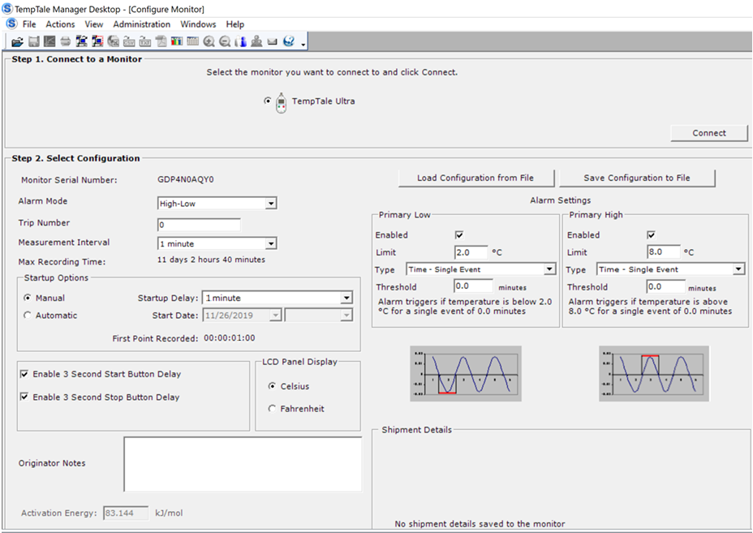
H
I
K
J

Slide 26
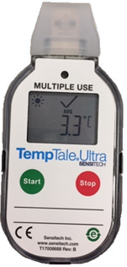
Step 2. Select Configuration
Letter | Field | Description
L | Enable 3 Second Start Button Delay | Click to check box to enable. When enabled, the monitor will not start until the Start button is pressed and held for 3 seconds.
M | Enable 3 Second Stop Button Delay | Click to check box to enable. If enabled, the monitor will not stop until the Stop button is pressed and held for 3 seconds (or until the maximum number of data points has been recorded).
N | LCD Display – Celsius or Fahrenheit | Select Celsius. This is the display temperature value that will appear on the LCD panel of the monitor.

Slide 27
L
M
N

Slide 28
Step 2. Select Configuration
Letter | Field | Description
O | Originator Notes | Enter a comment of up to 192 characters for the TempTale Ultra monitor. They are then display-only in Monitor Views. After monitor data are downloaded, the Originator Notes appear at the top of the Graph and Composite Views windows and at the bottom of the Summary View window. You can add comments at the bottom of any Monitor View (Graph, Tabular, Summary, Composite). Suggested: TempTale Expires YYYY MM DD (use validation due date).
P | Activation Energy | Display only. The default value is 83.144 kJ/mol. The activation energy value is used to calculate mean kinetic temperature (MKT).

Slide 29
O
TempTale Expires _date_
P

Slide 30
Step 2. Select Configuration
Letter | Field | Description
PDF Options
Q | Time Zone Use in PDF | Default is GMT time zone. Optional (suggested) to fill the Daylight Saving check box.
R | PDF Language | Select a language for the PDF report: English is the default.
S | Add Alarm Status Prefix | Optional. Selecting will add the monitor’s alarm status to the monitor’s generated TTV and PDF file names.

Slide 31
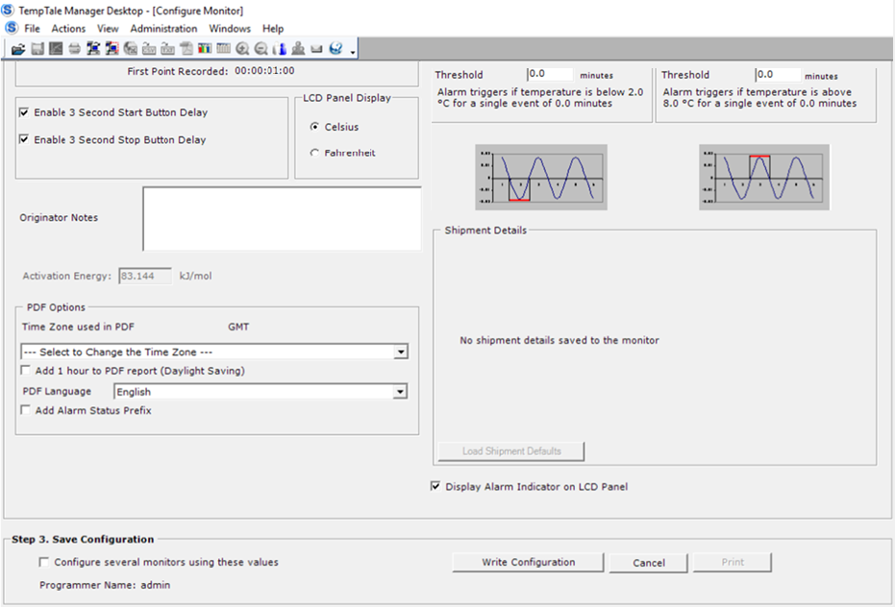
Q
R
S

Slide 32
Step 2. Select Configuration
Letter | Field | Description
T | Load Configuration from File (Not mandatory) Press this to pull up a configuration that has been previously saved. | Click to open a previously saved configuration. In the open window that appears, browse (if necessary) to the location of the saved configuration file. In a configuration loaded from file, you can modify Trip Number [E] and Originator Notes [P]. In addition, you also can modify: Time Zone options. PDF Language. Alarm Status Prefix options.
U | Save Configuration to File (Not mandatory) Press this to save a configuration to pull up later. | Click to save the current configuration to file. A Save As window will appear. Click Browse to the location at which you want to save configuration file.

Slide 33
T
U

Slide 34
Step 2. Select Configuration
Letter | Field | Description
Alarm Settings Primary Low, Primary High
V | Primary Low and Primary High – Enabled | Select the check box to enable. This allows the data entry for alarm configuration settings.
W | Primary Low and Primary High – Limit | Enter the low/high temperature value. This is the value beyond which the monitor should not be exposed. Set primary low to: Low 2.0 °C Set primary high to: High 8.0 °C

Slide 35
V
W

Slide 36
Step 2. Select Configuration
Letter | Field | Description
X | Type (select from the drop-down menu)
 | Time – Single Event Time – Cumulative | Select this field from the drop-down menu: The alarm will trigger if the temperature or humidity is above or below the limit (outside the ideal range) for a single period of time equal to or greater than the defined Threshold time [Y]. If selected. Same as above, but for an accumulated period of time (consecutive or non-consecutive).
Y | Threshold | Select 0.0 minutes (default). This is the amount of time (single or cumulative) in minutes after which an alarm should trigger.

Slide 37
X
Y

Slide 38
Alarm will trigger in relation to selected:
[W] Temperature limit, and
[Y] Threshold time.

Slide 39
Step 2. Select Configuration
Letter | Field | Description
Z | Display Alarm Indicator on LCD Panel | Check box is filled by default. No action required. Ensures that an alarm icon (X) will appear on the monitor’s LCD panel when an alarm has triggered.
Shipment Details - Display only, no action required.

Slide 40
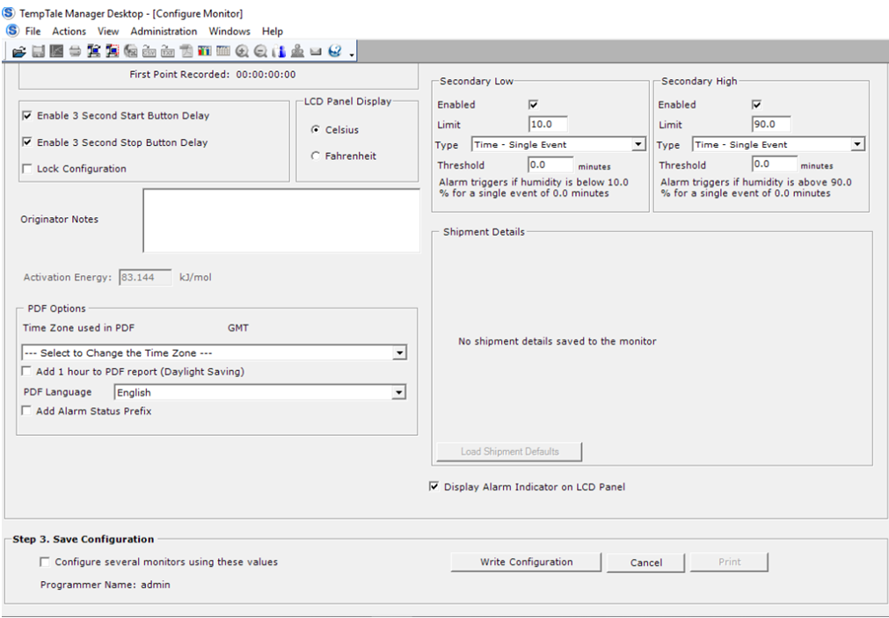
Z

Slide 41
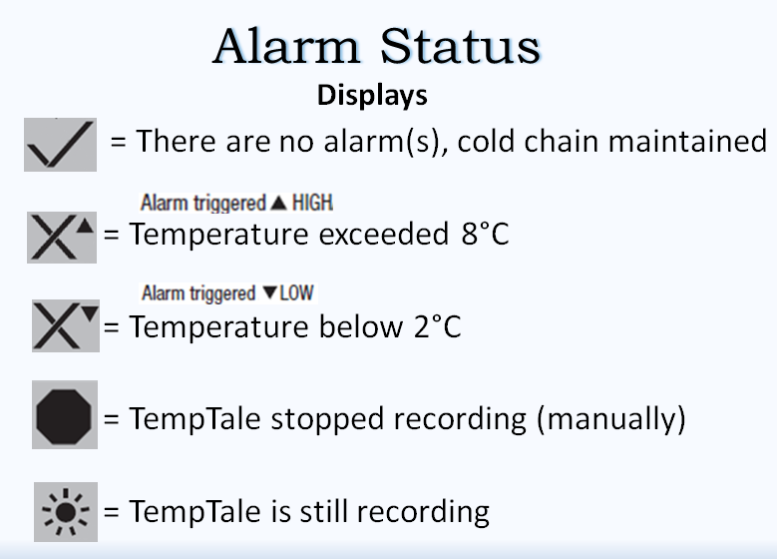
Image from slide #19 of the TempTale Ultra: User Information Guide.

Slide 42
Step 3. Save Configuration
Letter | Field | Description
Aa | Configure several monitors using these values (Optional) | Click to fill check box: Allows you to configure additional monitors using the same configuration values. When configuring additional monitors, you are able to modify Trip Number [E] and Originator Notes [O]. All other fields will turn to display only.
Bb | Write Configuration | Click “Write Configuration.” This will save the configuration to the monitor.
Cc | Print | After you have written the configuration, the Print button will activate. Click to preview and print the Configuration window.

Slide 43
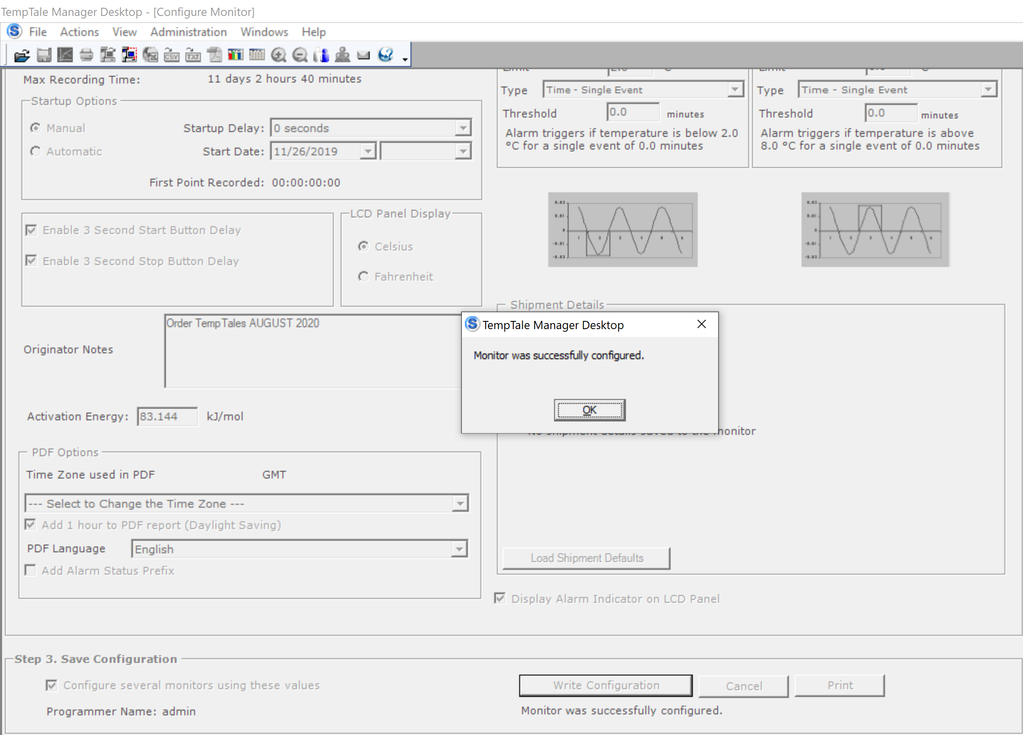
Click “Write Configuration” [Bb]
TTMD box appears.
Click “ok,” print option becomes available [Cc].
Done! You may close the window!
Aa
Bb
Cc

Slide 44
Summary
Configuring a TempTale
Plug the TempTale into USB port.
Double click TTMD 8.3 app from the pop- up window or on the computer desktop.
At the top left-hand of screen, click “Actions” → “Configure Monitor.”
Enter Suggested Settings. (Next slide).
Write the configuration. Done.
Safely remove TempTale from USB port.
The TempTale can now be used.

Slide 45
Summary
Suggested Settings
Letter | Field | Suggested
D | Alarm Mode | Set to High-Low
E | Trip Mode | 0
F | Measurement Interval | 1 minute (or 3 minutes over Christmas)
I | Startup delay | 1 minute
L | Enable 3 second start button delay | Enabled
N | LCD panel Display | Celsius
R | Set time zone and Daylight savings option | Mountain Standard (GMT)
W | Alarm Settings - Primary Low | Enabled, Limit 2.0, Type: Time -Cumulative, Threshold 0.0 Minutes
 | Alarm Settings - Primary High | Enabled, Limit 8.0, Type: Time - Cumulative, Threshold 0.0 Minutes

Slide 46
Note:
A TempTale will usually only have to be configured (set up) once.
A quick review of the settings will be done when the TempTale is downloaded (cleared).
See Reconfiguring TempTale presentation for use of TempTale.

Slide 47
Configuring a TempTale Ultra
Please call Brent (780-495-8903) or Christina (780-495-5439) if you have any questions.

